Slide 1

Mini Project Second Review Presentation on
Ambulance Task Offloading In Vehicular Edge Computing Networks Using Genetic Algorithm.
SIDDAGANGA INSTITUTE OF TECHNOLOGY, TUMKUR
Department of Information Science and Engineering
Under the guidance of
Dr.Keerthan Kumar T G
Assistant Professor
Dept. of ISE, SIT, Tumakuru
By
Sahana M T: 1SI23IS085
Varshitha S: 1SI23IS118
Vattaluru Rishitha: 1SI23IS119
Vidya: 1SI23IS120

Slide 2
OUTLINE
Outline
Problem statement
Introduction
Objectives
Literature Survey
Implementation
  System Architecture
  Algorithm and Methodology
Outcomes
References
Dept. of ISE, SIT, Tumkur
2

Slide 3
PROBLEM STATEMENT
Problem Statement
Ambulances need to process data quickly for routing, hospital selection, and patient care, but relying only on onboard systems causes delays and high energy use. Vehicular Edge Computing (VEC) can help by offloading tasks to nearby servers, yet current methods struggle to adapt to changing traffic and network conditions. To overcome this, a Genetic Algorithm (GA) can be used to make faster, smarter offloading decisions, reducing delays and improving emergency response.
Dept. of ISE, SIT, Tumkur
3

Slide 4
INTRODUCTION
Introduction
Ambulances generate a lot of real-time data that needs to be processed quickly for life-saving decisions.
Relying only on onboard systems can cause delays and high energy use during emergencies.
Vehicular Edge Computing (VEC) helps by sending (offloading) these tasks to nearby roadside servers for faster processing.
Choosing the best edge server or hospital in real time is difficult because traffic and network conditions keep changing.
Using a Genetic Algorithm (GA) makes this process smarter — it selects the most efficient option, reducing delay and improving emergency response time.
Dept. of ISE, SIT, Tumkur
4

Slide 5
OBJECTIVES
Objectives
Enable ambulances to process critical data faster using Vehicular Edge Computing (VEC).
Using Genetic Algorithm (GA) to smartly decide where to offload tasks, reducing delays in routing and hospital assignment.
Improve emergency response by making faster, more reliable decisions while efficiently managing network and computing resources.
Dept. of ISE, SIT, Tumkur
5

Slide 6
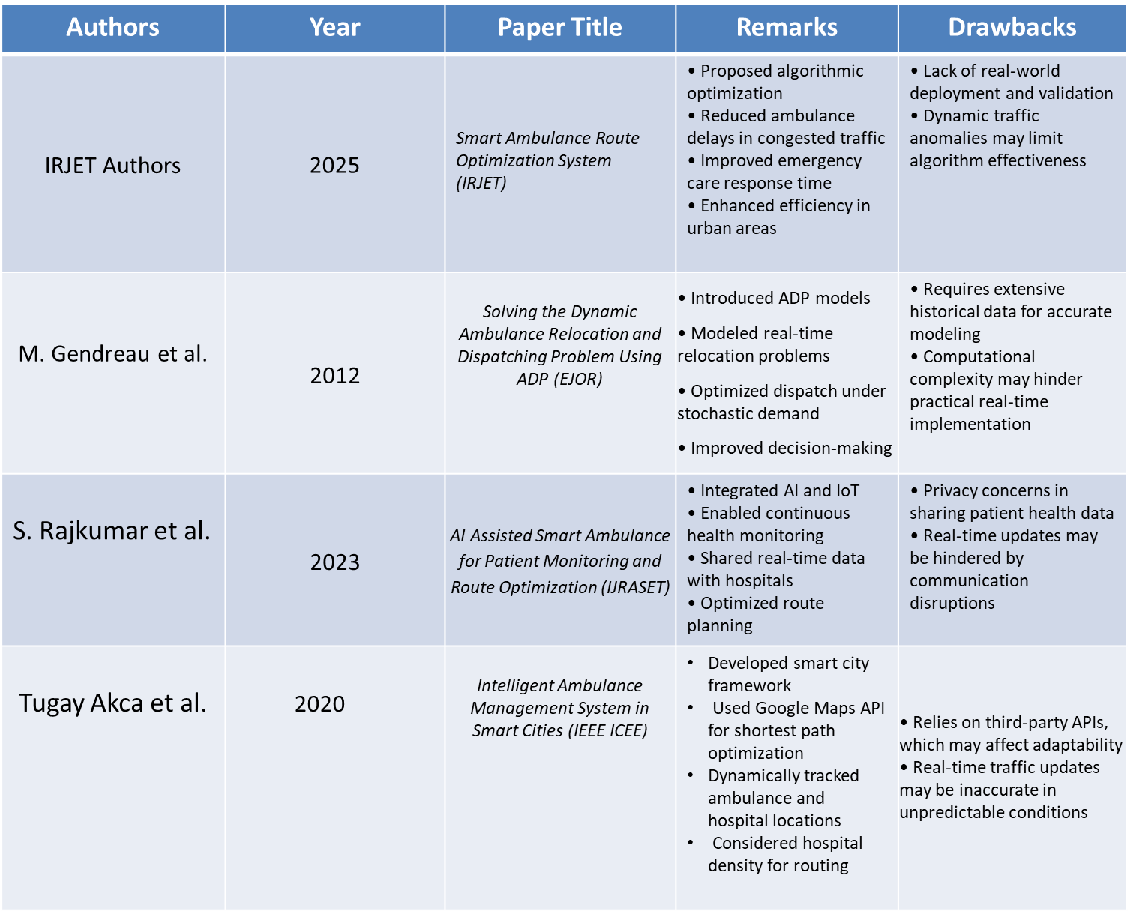
LITERATURE SURVEY
Literature Survey
Dept. of ISE, SIT, Tumkur
6

Slide 7
OUTCOME OF THE LITERATURE SURVEY
Literature Survey
Real-time tracking and routing: IoT and AI allow us to track ambulances, monitor patients, and find the best routes instantly.
Dealing with uncertainty: Advanced techniques help manage unpredictable traffic and quickly relocate emergency vehicles.
Faster performance: Edge computing makes the systems more efficient and scalable by reducing delays.
Future goals: We still need to improve communication reliability, data security, and address ethical concerns to ensure these systems are safe and effective.
Dept. of ISE, SIT, Tumkur

Slide 8
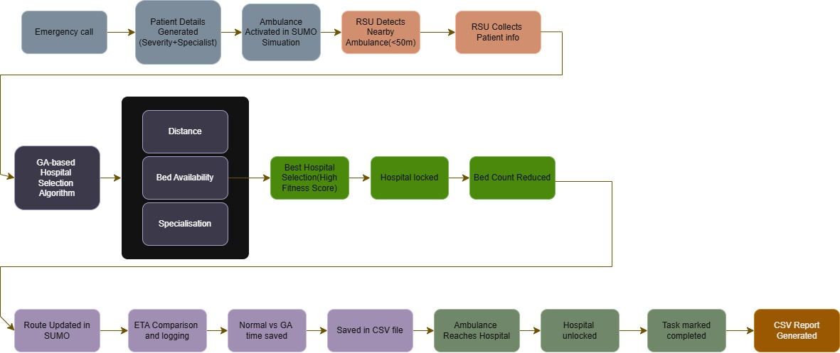
ARCHITECTURE OF PROPOSED MODEL/ BLOCK DIAGRAM
Proposed Work : Architecture
Dept. of ISE, SIT, Tumkur
8

Slide 9
Algorithms Used
Genetic Algorithm (GA):
Definition: A bio-inspired optimization algorithm that uses the principles of natural selection, crossover, and mutation to find the best solution among many possibilities
GA Steps:
1.Initialization:Each hospital is considered a possible solution for an ambulance.
2. Fitness Calculation:The fitness of each hospital is calculated using distance, beds, and specialization match.
3. Selection:The top hospital(s) with the highest fitness values are selected.
4. Crossover / Mutation (Simplified):sorting + re-selection.
5. Final Selection:The hospital with the highest fitness score is chosen as the destination.

Slide 10
Formulae used:
Distance=[(x1​−x2​)^2+(y1​−y2​)^2]^1/2​
Used to calculate the straight-line distance between the ambulance and a hospital or RSU.
ETA (min)=Distance (m)/1000​×60/50​
Converts distance to travel time (minutes), assuming a speed of 50 km/h
ETA Score=max(0,1−ETA/Max ETA​)
Normalizes ETA to a score between 0 and 1 (higher = better/closer)
Bed Score=min(1,Available Beds/5​)
Normalizes hospital capacity
Spec Score={1,if specialist is available
0,if not​
Checks if the hospital has the required doctor
Fitness=0.6×ETA Score+0.3×Bed Score+0.1×Spec Score
Combines all factors to decide the best hospital

Slide 11
Methodology
Ambulances move in a simulated city using SUMO.
Nearby RSUs (traffic lights) detect ambulances within 50 meters.
When detected, the RSU runs a Genetic Algorithm (GA) to pick the best hospital.
GA scores hospitals based on: distance (60%), beds available (30%), and specialist match (10%).
The ambulance is routed to the selected hospital, and ETA is recorded to measure improvement.

Slide 12
Implementation
Ambulances move through the city in a SUMO simulation, just like real traffic.
Nearby RSUs (traffic lights) detect ambulances within 50 meters.
When detected, a Genetic Algorithm (GA) picks the best hospital for each ambulance.
Hospitals are scored based on distance (60%), available beds (30%), and specialist match (10%).
The ambulance’s route is updated to the selected hospital, and the ETA is logged to track improvements.
The whole process, including traffic, ambulance movement, and hospital assignment, is visualized in SUMO, and results are saved in a CSV file for analysis.
We compare normal ETA score and ETA score of GA and represent it in Graph from.

Slide 13
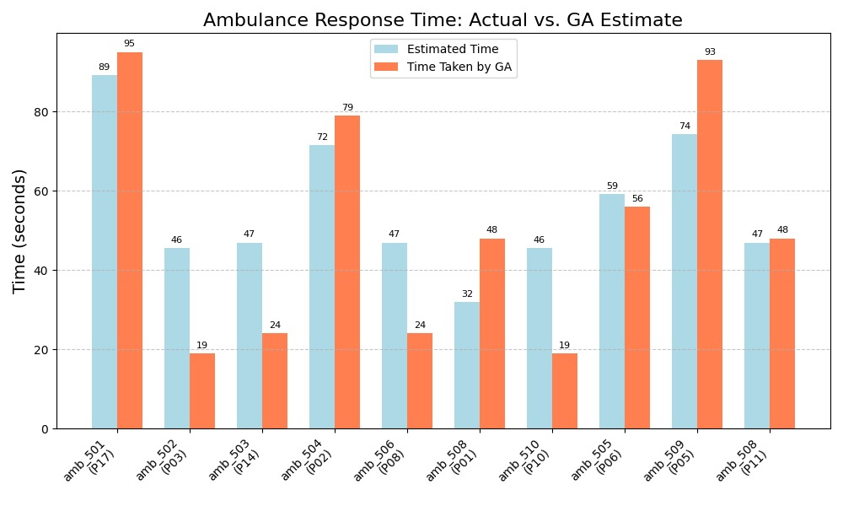
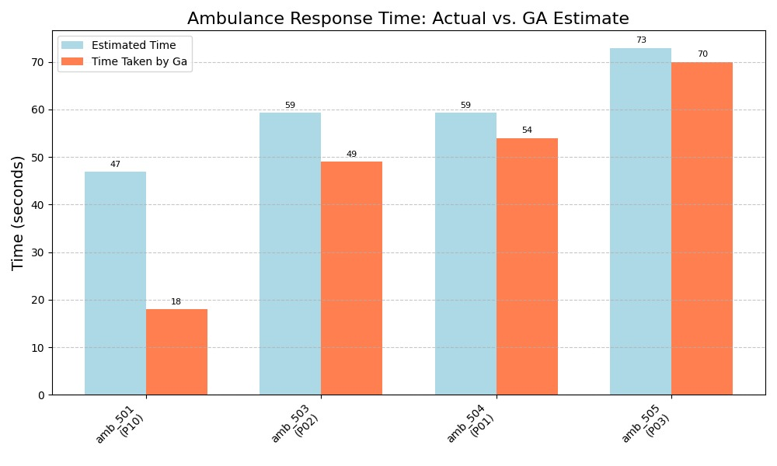
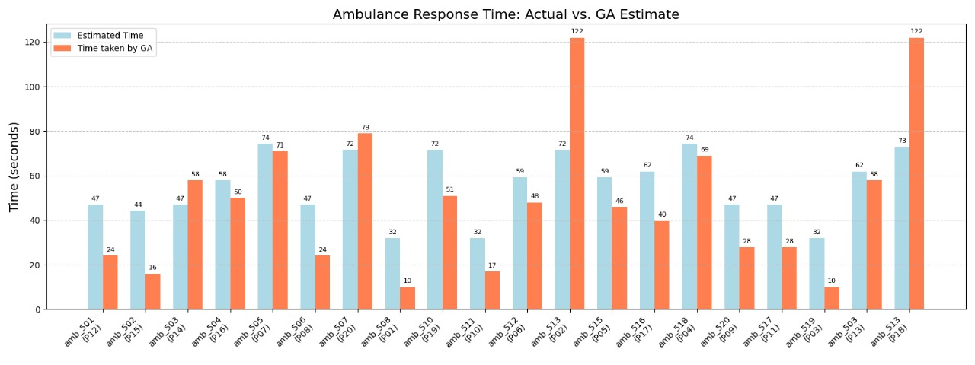
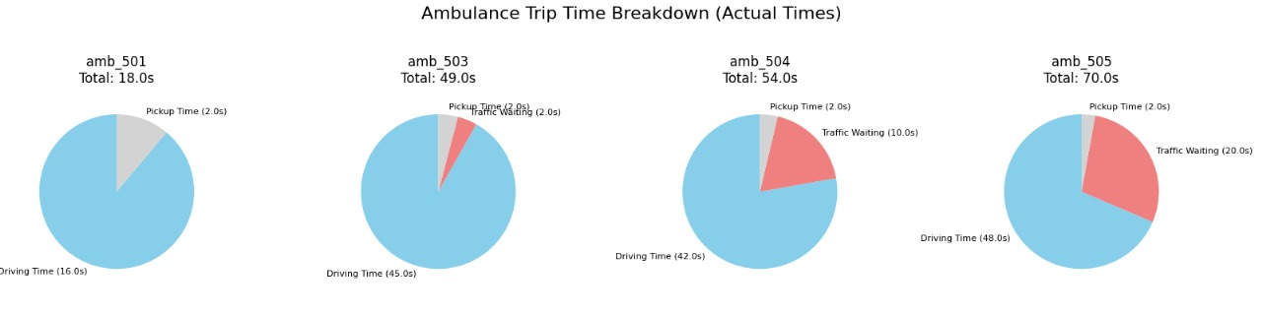
OUTCOMES
13

Slide 14
REFERENCES
References
[1] R. Sumathi, A. Kumar, P. Sharma, and K. Verma, "Smart Ambulance Routing System," International Journal of Creative Research Thoughts (IJCRT), vol. 12, 2024, ISSN: 2320-2882.
[2] T. Akca, E. Kocyigit, Ö. K. Sahingoz, and M. Tozal, "Intelligent Ambulance Management System in Smart Cities," IEEE International Conference on Electrical and Electronics Engineering (ICEE), 2020, ISSN: 978-1-7281-3781-7.
[3] IRJET Authors, "Smart Ambulance Route Optimization System," International Research Journal of Engineering and Technology (IRJET), vol. 8, 2025, ISSN: 2395-0056.
[4] M. Gendreau, G. Laporte, and F. Semet, "Research (EJOR), vol. 219, no. 3, 2012, ISSN: 0377-2217. Solving the Dynamic Ambulance Relocation and Dispatching Problem Using ADP," European Journal of Operational
[5] S. Rajkumar, P. Karthik, R. Bhuvaneswari, and V. Ramesh, "AI Assisted Smart Ambulance for Patient Monitoring and Route Optimization," International Journal for Research in Applied Science and Engineering Technology (IJRASET), vol. 11, 2023, ISSN: 2321-9653.
[6] Shalini S., C. Nandini, G. Shree R., M. Yasaswini, and N. Jain, "Greenvoy: A Survey On Smart Ambulance Routing Through Green AI and Edge Intelligence," International Journal of Science, Engineering and Technology (IJSET), vol. 13, 2025, ISSN: 2348-4098.
[7] M. Fakhouri Amr, M. Elgarej, N. Benmoussa, K. Mansouri, and M. Qbadou, "Towards a Distributed SMA-based Solution for the Interoperability of Hospital Information Systems for Better Routing of Emergency Ambulances," International Journal of Online Engineering (iJOE), vol. 17, no. 4, 2021, ISSN: 1861-2121.
[8] Md. Rakibul Hassan, "Enhancing Task Offloading in Vehicular Networks: A Multi-Agent Cloud-Edge-Device Framework," Vehicular Communications, vol. 36, 2025, ISSN: 2214-2096
Dept. of ISE, SIT, Tumkur
14

Slide 15
Thank you, everyone!

